Slide 1

VINJAMURI DEVI BHAVANI
Final Project
1

Slide 2

KEY LOGGER AND SECURITY
Understanding and Mitigating Keylogging Threats
2

Slide 3




AGENDA
Introduction
Problem Statement
Project Overview
End Users
Solution and Value Proposition
The "Wow" Factor in Our Solution
Modelling
Results
Conclusion and Q&A
3

Slide 4


PROBLEM STATEMENT
Problem:
Keyloggers are a significant threat to cybersecurity,
leading to unauthorized access to sensitive information,
identity theft, and financial fraud.
Impact:
Affects individuals, businesses, and organizations by
compromising data privacy and security.
4

Slide 5
PROJECT OVERVIEW
Objective:
Develop a comprehensive understanding of keyloggers,
their types, how they work, and effective security measures to
prevent keylogging attacks.
Scope:
Includes an analysis of hardware and software keyloggers,
legal and ethical implications, security measures, and
best practices.
5

Slide 6
WHO ARE THE END USERS?
Individuals: Concerned about personal data security and privacy.
Businesses: Need to protect corporate data and ensure
compliance with security standards.
Organizations: Require robust security measures to safeguard
sensitive information.
Security Professionals: Aim to understand and mitigate
keylogging threats.
6

Slide 7

YOUR SOLUTION AND ITS VALUE PROPOSITION
To avoid keyloggers
Use anti virus program
Use password manager
Use multi factor authentication
Use a firewall
Avoid suspicious links and downloads
Change password periodically
Update your system
Use Virtual Keyboard to type passwords and
sensitive information
7

Slide 8
PROPOSITION
Enhanced Security: Reduces the risk of data
breaches and identity theft.
User Awareness: Educates users about keylogging
threats and protection methods.
Compliance: Helps businesses and organizations
comply with data protection regulations.
8

Slide 9

THE WOW IN YOUR SOLUTION
Innovative Approach: Combining technical measures
with user education for comprehensive protection.
Demonstration: Real-time demonstration of a simple
keylogger to illustrate the threat and the effectiveness
of security measures.
Impact: Significant reduction in the likelihood of
keylogging attacks through proactive measures.
9

Slide 10
MODELLING
Architecture Overview:
Modular Design: The keylogger code is structured into modular functions for better readability and maintenance.
Event Handling: Utilizes the pynput library to capture and handle keyboard events.
Data Logging: Implements functions to log captured data into text and JSON files.
10

Slide 11
Components:
Key Press Handling: Function: on_press(key)
Description: Captures and logs the pressed keys.
Details: Appends key press events to a list and updates the JSON log file.
Key Release Handling: Function: on_release(key)
Description: Captures and logs the released keys.
Details: Appends key release events to a list, updates the JSON log file, and accumulates keys for the text log.
Logging Functions:
Text Logging: generate_text_log(key)
Description: Writes the recorded keys to key_log.txt.
JSON Logging: generate_json_file(keys_used)
Description: Dumps the list of key events to key_log.json.
11

Slide 12
GUI Integration:
Tkinter Framework: Utilizes tkinter for creating a graphical
user interface.
User Interaction:
Start Button: Initiates the keylogger.
Stop Button: Stops the keylogger.
Status Updates: Provides real-time feedback on the status
of the keylogger (running/stopped).
12

Slide 13
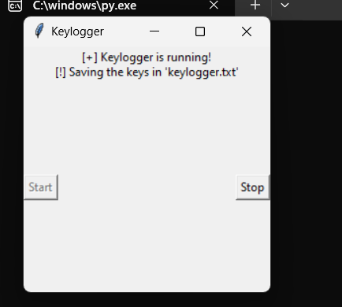
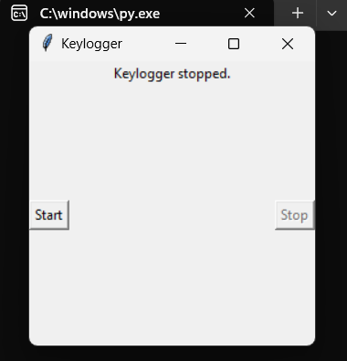
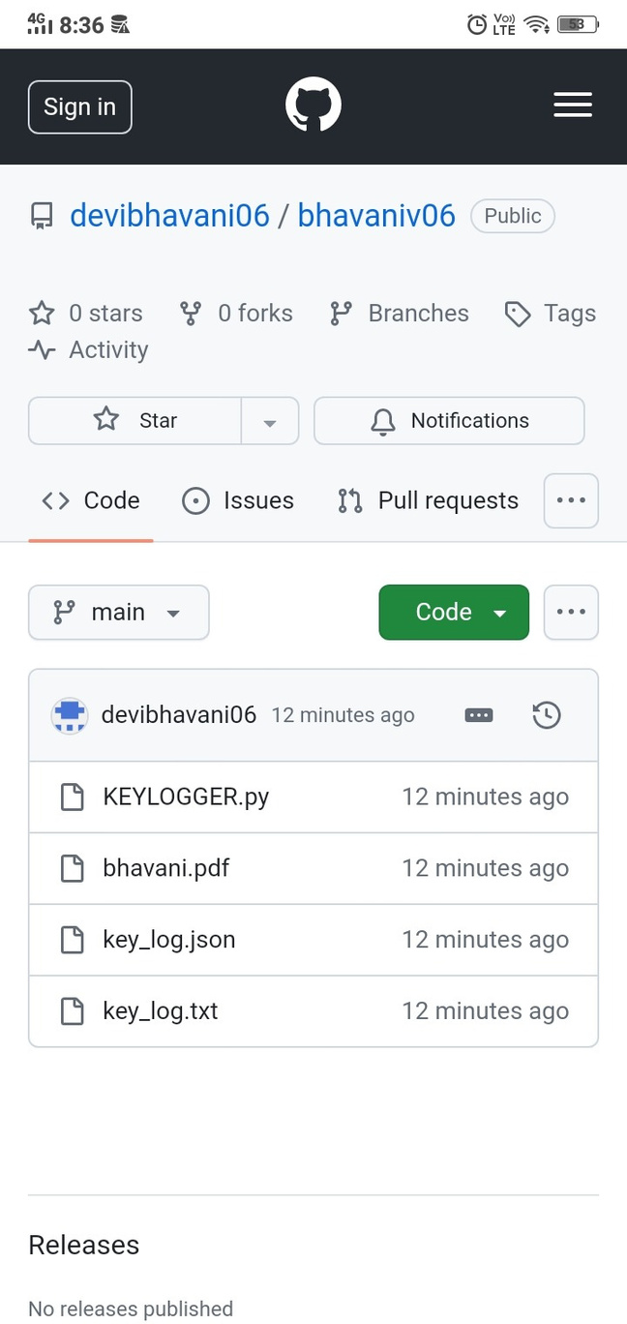
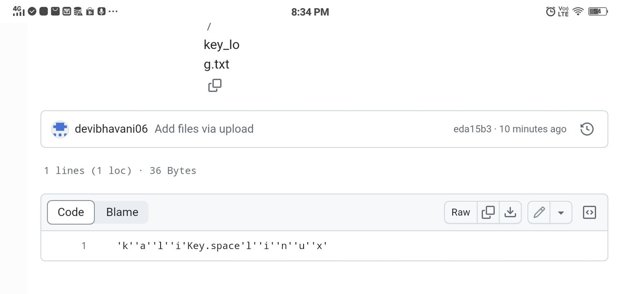
RESULTS
13

Slide 14
Successfully implemented a keylogger that captures keystrokes
and records them into both text and JSON files.
Real-time keylogging with start and stop functionality controlled
via a simple GUI.
The keylogger project demonstrated the capability to effectively
capture and log keystrokes in real-time.
The GUI provided a user-friendly way to control the keylogger,
making it accessible and easy to use.
Emphasized the ethical use of keyloggers and the importance
of implementing security measures to protect against
malicious use.
14

Slide 15
Thank You

